Slide 1
CRITICAL SECTION

Slide 2
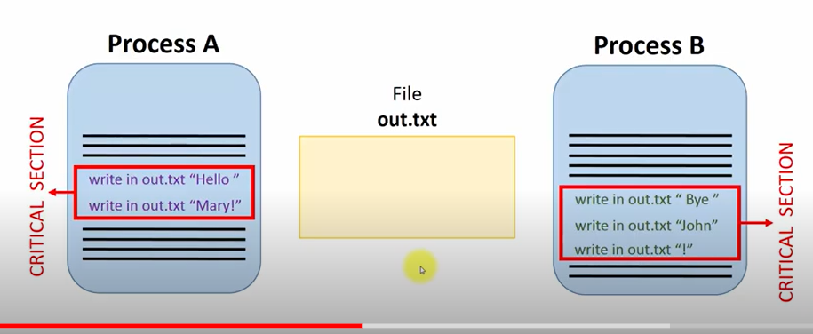
ONLY ONE PROCESS ACCESS A SHARED RESOURCE AT A TIME
The process enter the criticial section when it starts to execute the first command and leave the critical section when it starts to execute the last command.

Slide 3
CRITICAL SECTION
When concurrent processes interact through a shared variable,the integrity of the variable may be violated if access to the variable is not co ordinated.
Example of integrity violations
Variable does not record all changes
a process may read inconsistent values
The final value of the variable may be consistent

Slide 4
The process must be synchronized such that only one process can access the variable at any one time.
This is known as mutual exclusion.
A critical section is a code segment in a process in which a shared resource is accessed.

Slide 5
Solution to the problem of mutual exclusion must satisfy the following requirement
Only one processor can execute its critical section at any one time.
When no process is executing in its critical section,any process that requests entry to its critical section must be permitted to enter without delay.
When two or more process compete to enter their respective critical section,the selection cannot be postponed indefinitely.
No process can prevent any other process from entering its critical section indefinitely; that is every process should be given a fair chance to access the shared resource.

Slide 6
Here, are four essential elements of the critical section
Entry Section: It is part of the process which decides the entry of a particular process.
Critical Section: This part allows one process to enter and modify the shared variable.
Exit Section: checks that a process that finished its execution should be removed through this Section.
Remainder Section: All other parts of the Code, which is not in Critical, Entry, and Exit Section, are known as the Remainder Section.

Slide 7
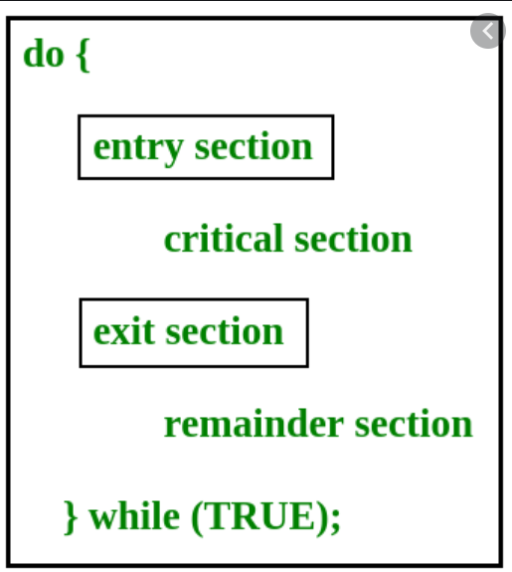

Slide 8
Solutions for critical section 1.Early mechanisms for mutual exclusion
a.Busy waiting
-process that cannot enter its critical section continuously tests the value of a status variable to find if the shared resource is free.
-the status variable checks whether the status of the shared resource.
-The main problem with this approach are the wastage of CPU cycles and the memory access bandwidth

Slide 9
b.Disabling interrupts
-is a mechanism where process disables interrupts before entering the critical section and enables the interrupts immediately after exiting the critical section
-a process is not interrupted during the execution of its critical section and thus excludes all the process from entering the critical section.

Slide 10
c.test and set Instruction
Used to achieve mutual exclusion.
The instruction completes a single indivisible operation on a designated/specific memory location.
When this instruction is executed a specific memory location is checked for a particular value,if they match the memory locations contents are altered.
Can be used as a building block for busy waiting or can be incorporated into schemes that relinquish the cpu when the instruction fails

Slide 11
2.Semaphore
It is a high level construct used to synchronize concurrent processes.
A semaphore S is an integer variable on which processes can perform two indivisible operations.
Each semaphore has a queue associated with it,where processes that are blocked on that semaphore wait

Slide 12
The P (wait) and S(signal) operation is defined as follows
P:wait(s) S:signal(s)
{
while(s<=0) ; { s=s+1;
s=s-1;
} }

Slide 13
Let P1,P2,P3,P4..n tries to enter into critical section
do let p1 enters
{ wait(s) s=1,s=0.
suppose if p2 enters
//critical section
Signal(s)
//remainder section
}
While(T)

Slide 14
Semaphore classified into two types
Binary semaphore-initial value is 1.
Resource counting semaphore-initial value is normally more than 1.

Slide 15
Solution to mutual exclusion using semaphore
Shared var
mutex:semaphore(=1);
Process i(i=1,n);
begin
……
P(mutex);
execute CS;
V(mutex);
……
end

Slide 16
Consider if process P1 and P2 is there Process P1 enters into the critical section,performs its work in critical section and leaves the critical section by incrementing the value by one by performing the signal operation.
Then Process P2 can enter the critical section

Slide 17
We can use a binary semaphore to achieve mutual exclusion.
If any process has performed a P (mutex) operation without performing the corresponding V (mutex) operation(ie the process is still inside the critical section),then all the other process trying to enter the critical section will wait on the P(mutex) operation until this process performs the V(mutex) operation(ie exits the critical section).
Therefore mutual exclusion is achieved.

Slide 18
For any semaphore
Number of P operations-Number of V operations <=initial value
Eg:)A counting semaphore S is initialized to 10. Then, 6 P operations and 4 V operations are performed on S. What is the final value of S?
10-6+4=8

Slide 19
Drawbacks of Semaphore
A process that uses a semaphore has to know which other processes use the semaphore.It may also have to know those processes are using the semaphore to ensure co ordination
Semaphore operations must be carefully installed in a process.The omission of a P or V operation may result in inconsistencies or deadlocks.
Programs using semaphore are extremely hard to verify for correctness.

Slide 20
Other synchronization Problems (CLASSIC SYNCHRONIZATION PROBLEMS)
Here also concurrent access to shared resource is essential
The Dining Philosopher’s Problem
The Producer-Consumer Problem
The Reader’s Writer’s Problem

Slide 21
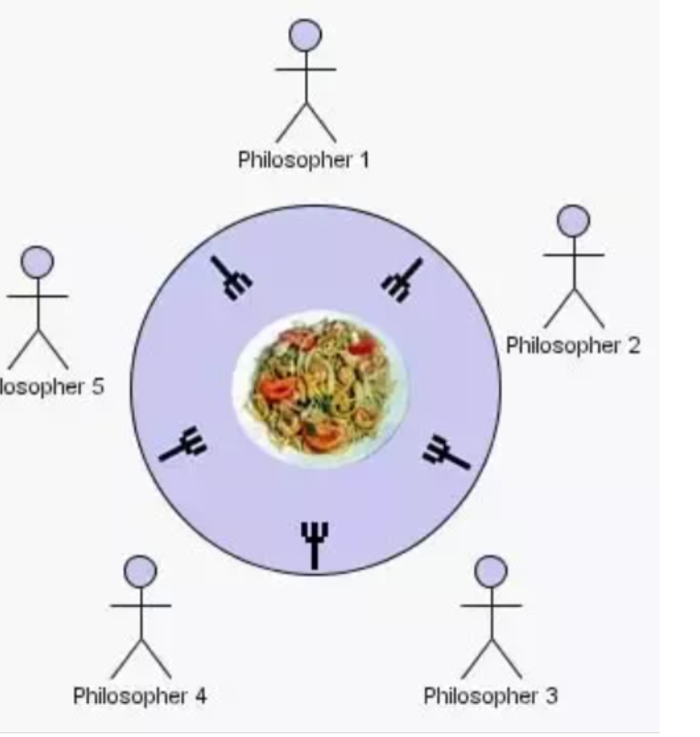
The Dining Philosopher’s Problem
2
3
4

Slide 22
The dining philosophers problem states that there are 5 philosophers sharing a circular table and they eat and think alternatively.
There is a bowl of rice for each of the philosophers and 5 chopsticks.
A philosopher needs both their right and left chopstick to eat.
A hungry philosopher may only eat if there are both chopsticks available.
Otherwise a philosopher puts down their chopstick and begin thinking again.

Slide 23
Note : 1.No two neighbouring philosopher’s can eat simultaneously.
2.The act of picking up a fork should be done in critical section.
3.Devising a deadlock free solution is not easy.

Slide 24
The Producer Consumer Problem
Here a set of producer process supplies messages to a set of consumer process.
These processes share a common buffer pool where messages are deposited by producers and removed by consumers
All the processes are asynchronous
No consumer process can remove when the buffer pool is empty and no producer can deposit a message when the buffer pool is full.
Integrity problems may arise if multiple consumers try to remove messages in the buffer pool simultaneously.so we use critical section here.

Slide 25
The Reader’s Writer’s Problem
A shared resource is a file that is accessed by both the reader and the writer.
Reader process simply read the information in the file without changing its contents.
Writer process may change the information in the file.
The basic synchronization constraint is that any number of readers should be able to concurrently access the file,but only one writer can access the file at a given time.

Slide 26
There are several versions of the problem whether readers or writers are given priority
Reader’s Priority:
Arriving readers receive priority over waiting writers.
A waiting or arriving writer gains access to the file only when there are no readers in the system.
When the writer is done with the files,all the waiting readers have priority over the waiting writers.

Slide 27
Writer’s Priority:
Arriving writers receive priority over waiting readers.
A waiting or arriving reader gains access to the file only when there are no writers in the system.
When the reader is done with the files,all the waiting writers have priority over the waiting readers.

Slide 28
The writers may starve in the reader’s priority case and vice versa.
To overcome this we use a weak reader’s priority case or a weak writer’s priority case.
In a weak reader’s priority case the arriving reader still has priority over waiting writers.
However when a writer departs,both waiting readers and waiting writers have equal priority.

Slide 29
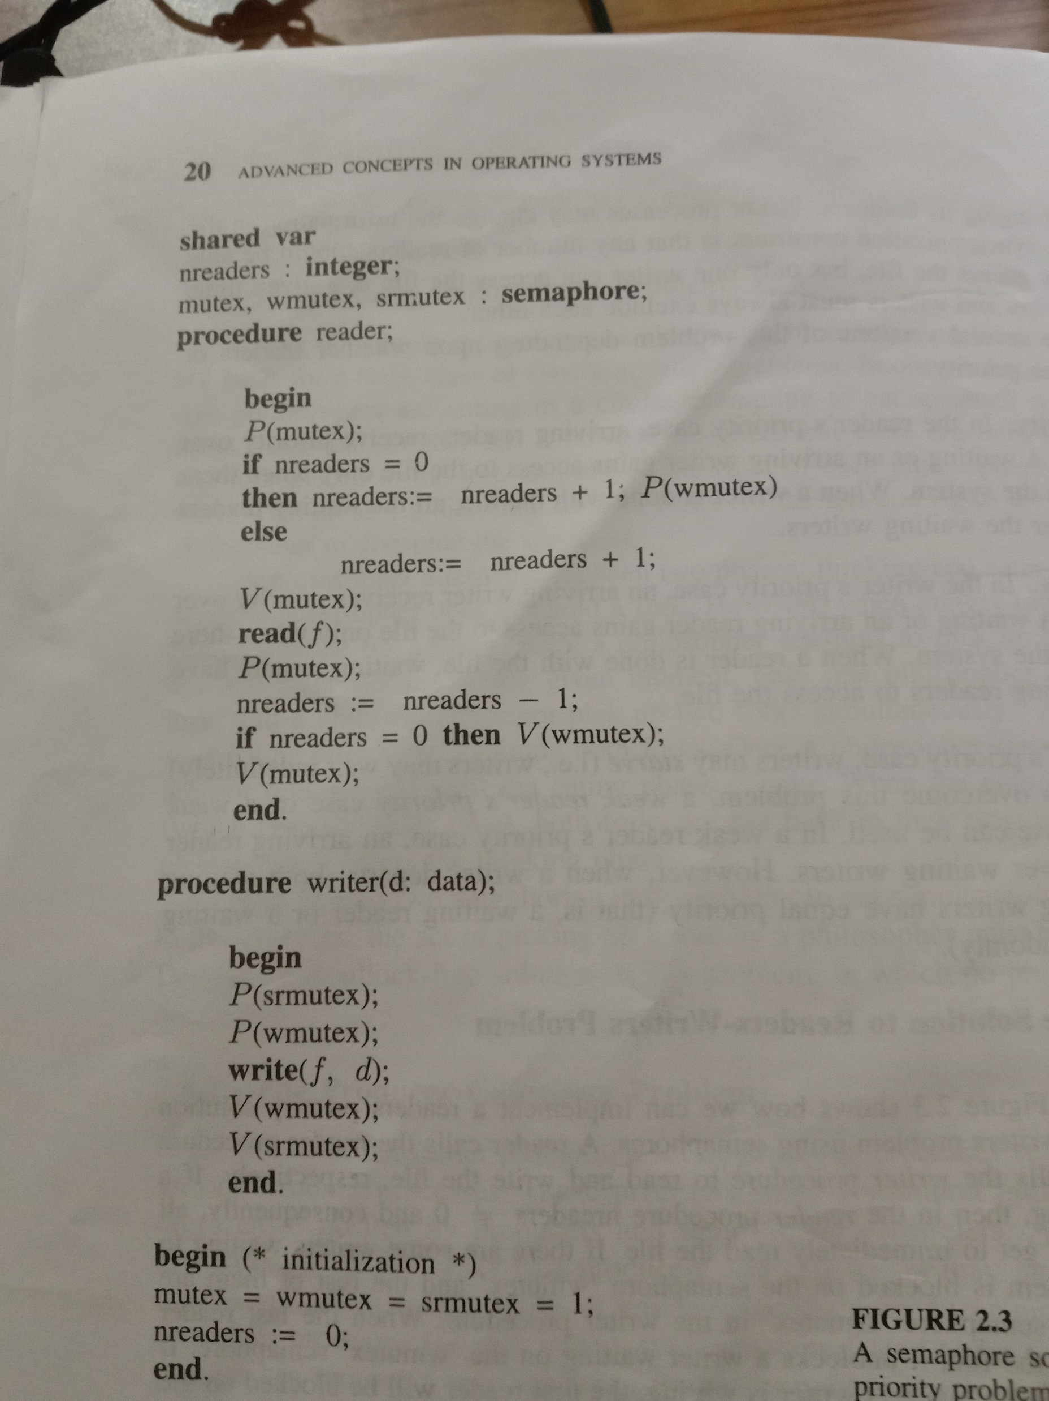
A semaphore solution to the reader’s priority problem

Slide 30
A reader calls a reader procedure and a writer calls a writer procedure to read and write the files respectively.
If the reader is reading then in the reader procedure nreaders!=0 and consequently all arriving readers get to immediately read the file..
If there are some writers waiting to write,one of them is blocked on the semaphore ‘wmutex’ and the rest of them are blocked on the semaphore ‘srmutex’ in the writer procedure.

Slide 31
When the last reader finishes reading the file,it unblocks a writer waiting on the ‘wmutex’ semaphore.
If some readers arrive while the writer is writing,the first reader will be blocked on the semaphore ‘wmutex’ and all the subsequent readers will be blocked on the semaphore ‘mutex’.
When the writer departs,its V(mutex) operation will unblock a waiting reader(if there is one) which subsequently causes all the waiting readers to unblock,one by one.

Slide 32
The departing writer performs a V(srmutex) operation that unblocks a writer (if there is one) waiting on P(srmutex)
Clearly this writer will be blocked at P(wmutex) if nreaders is greater than 0 this time.

Slide 33
Monitors
Monitors are abstract data types for defining shared objects (or resources) and for scheduling access to these objects in multiprogramming environment.
A monitor consists of procedures, the shared object(resources) and administrative data.
Procedures are gateways to the shared resource and are called by the process needing to access.

Slide 34
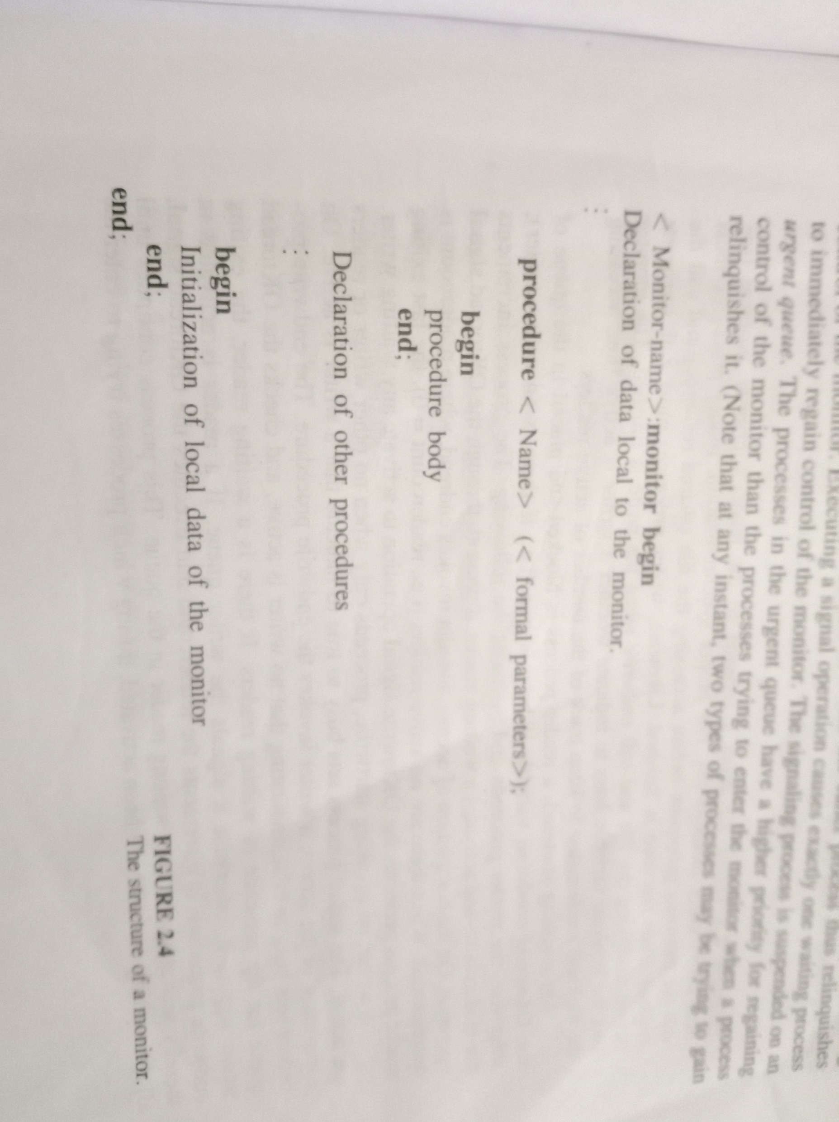
Structure of a Monitor

Slide 35
The execution of the monitor obeys the following constraints
Only one process can be active to ensure mutual exclusion.
Procedures of a monitor can only access data local to the monitor they cannot access an outside variable.
The variables or data local to a monitor cannot be directly accessed from outside the monitor.

Slide 36
Since the main function of a monitor is to control access to a shared resource it should be able to delay and resume the execution of the processes calling monitor’s procedures.
The synchronization processes is accomplished via two special operations,wait and signal,which are executed within the monitor’s procedures.
Executing a wait operation suspends the caller process and the caller process thus relinquishes control of the monitor.

Slide 37
Executing a signal operation causes exactly one waiting process to immediately regain control of the monitor.The signalling process is suspended on an urgent queue.
The processes in the urgent queue have a higher priority for regaining control of the monitor than the process trying to enter the monitor when a process relinquishes it.
When a waiting process is signalled,it starts execution from the very next statement following the wait statement.If there are no waiting process,the signal has no effect.

Slide 38
CONDITION VARIABLE
A conditional variable associated with wait and signal operations helps to distinguish the processes to be blocked or unblocked for different reasons.
It is associated with a queue of processes that are currently waiting on that condition
The operation <condition variable> queue returns true if the queue associated with the condition variable is not empty.
Otherwise it returns false

Slide 39
The syntax of wait and signal operations associated with a condition is:
<condition variable> .wait;
<condition variable>.signal;

Slide 40
Advantages
Flexibility that they allow in scheduling the process in the waiting queues.
FIFO discipline is generally used with queues,but priority queues can be implemented by enhancing the wait operation with a parameter.
The parameter specifies the priority of the process to be delayed.
The smaller the value of the parameter,the higher its priority
When a queue is signalled the process with the highest priority in that queue is activated.The syntax for the priority wait is:
<condition variable>.wait(<parameter>)

Slide 41
Drawback of Monitors
Absence of concurrency since one process can be active at a time.
For proper synchronization,procedures of the monitors must be invoked before and after accessing the shared resource.This arrangement however results in the improper accessing of resource without accessing the shared resources.
Possibility of deadlock in the case of nested monitor calls

